Slide 1

Linear Regression DR.Bhakti Palkar

Slide 2
What is LInear regression?
Linear regression is one of the easiest and most popular Machine Learning algorithms.
Linear regression makes predictions for continuous/real or numeric variables
Three main uses of regression analysis are:
Predicting share price
Analyzing the impact of price changes

Slide 3
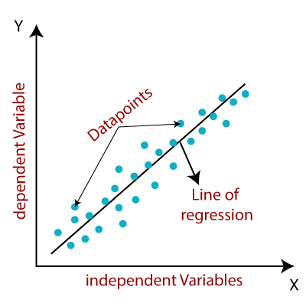
Linear regression
Linear regression shows the linear relationship, which means it finds how the value of the dependent variable (y) is changing according to the value of the independent variable (x).
The linear regression model provides a sloped straight line representing the relationship between the variables.

Slide 4
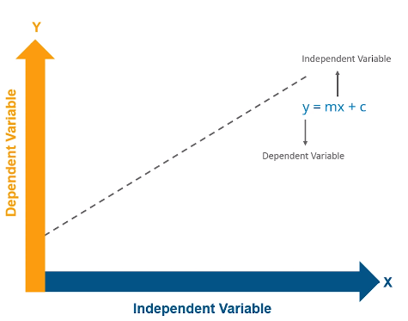
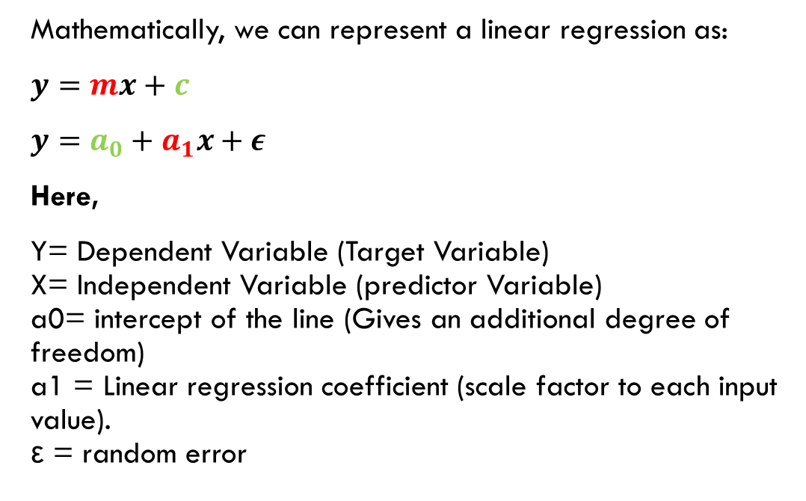
Linear regression
Mathematically, we can represent a linear regression as:
$y=mx+c$
$y=a_{0}+a_{1}x+ε$
Here,
Y= Dependent Variable (Target Variable) X= Independent Variable (predictor Variable) a0= intercept of the line (Gives an additional degree of freedom) a1 = Linear regression coefficient (scale factor to each input value). ε = random error

Slide 5
Types of linear regression
Simple Linear Regression: If a single independent variable is used to predict the value of a numerical dependent variable, then such a Linear Regression algorithm is called Simple Linear Regression.
Multiple Linear regression: If more than one independent variables are used to predict the value of a numerical dependent variable, then such a Linear Regression algorithm is called Multiple Linear Regression.

Slide 6
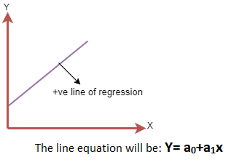
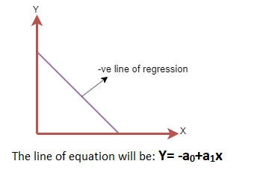
Linear Regression Line
Positive Linear Relationship: If the dependent variable increases on the Y-axis and independent variable increases on X-axis, then such a relationship is termed as a Positive linear relationship.
Negative Linear Relationship: If the dependent variable decreases on the Y-axis and independent variable increases on the X-axis, then such a relationship is called a negative linear relationship.

Slide 7
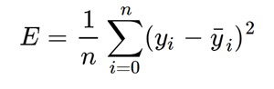
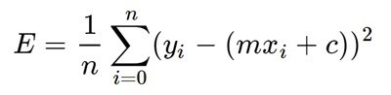
COST function
Goal: find the best fit line that means the error between predicted values and actual values should be minimized. The best fit line will have the least error.
Loss: Error in our predicted value of m and c. Our goal is to minimize this error to obtain the most accurate value of m and c. We will use the Mean Squared Error function to calculate the loss. There are three steps in this function:
Find the difference between the actual y and predicted y value(y = mx + c), for a given x.
Square this difference.
Find the mean of the squares for every value in X.

Slide 8
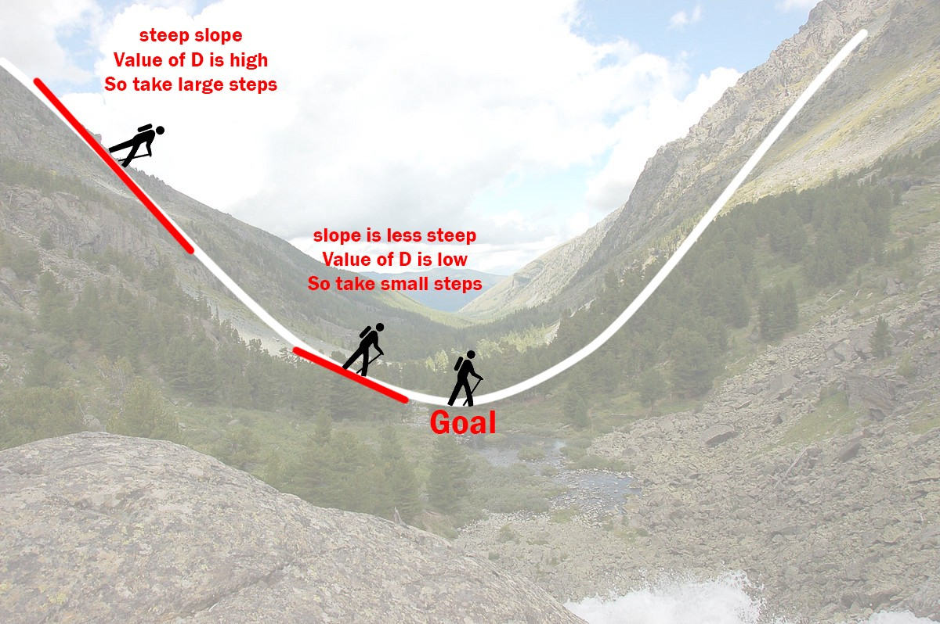
Gradient descent Algorithm
Gradient descent is an iterative optimization algorithm to find the minimum of a function. Here that function is our Loss Function.

Slide 9
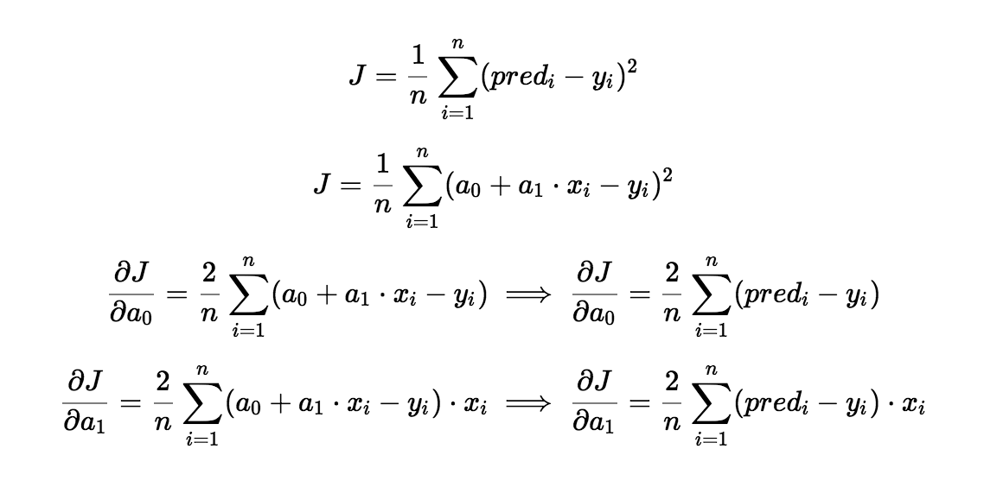
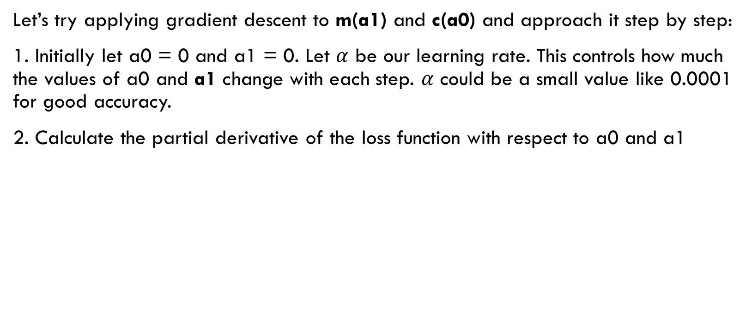
Gradient descent Algorithm
Let’s try applying gradient descent to m(a1) and c(a0) and approach it step by step:
1. Initially let a0 = 0 and a1 = 0. Let $α$ be our learning rate. This controls how much the values of a0 and a1 change with each step. $α$ could be a small value like 0.0001 for good accuracy.
2. Calculate the partial derivative of the loss function with respect to a0 and a1

Slide 10
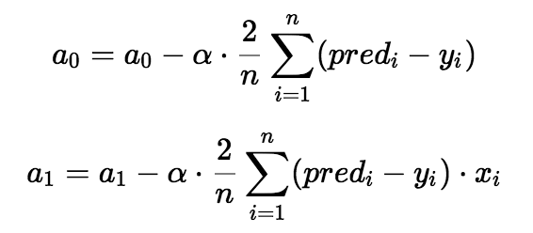
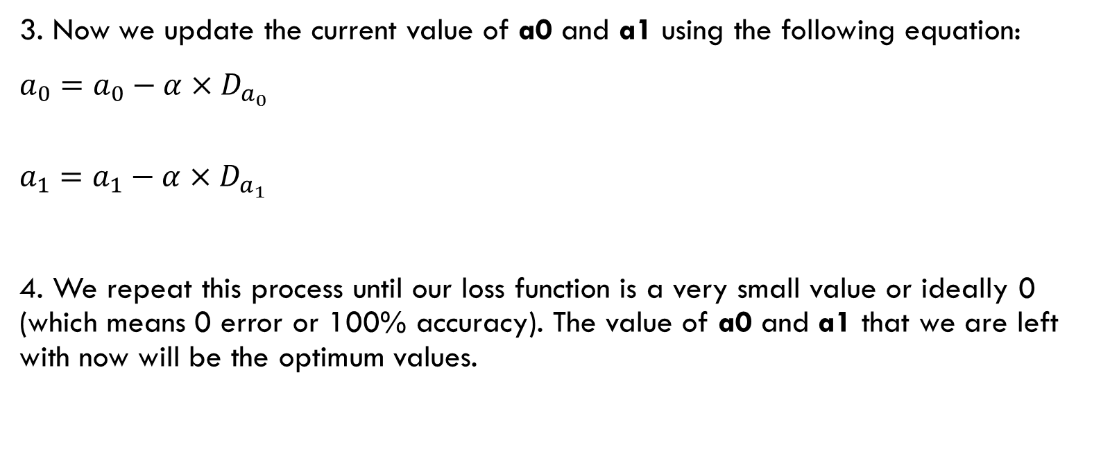
Gradient descent Algorithm
3. Now we update the current value of a0 and a1 using the following equation:
$a_{0}=a_{0}−α×D_{a_{0}}$
$a_{1}=a_{1}−α×D_{a_{1}}$
4. We repeat this process until our loss function is a very small value or ideally 0 (which means 0 error or 100% accuracy). The value of a0 and a1 that we are left with now will be the optimum values.

Slide 11
Gradient descent Algorithm
Now going back to our analogy, a0,a1 can be considered the current position of the person. D is equivalent to the steepness of the slope and alpha (learning rate) can be the speed with which he moves.
Now the new value of (a0,a1) that we calculate using the above equation will be his next position, and alpha×D will be the size of the steps he will take.
When the slope is more steep (D is more) he takes longer steps and when it is less steep (D is less), he takes smaller steps.
Finally he arrives at the bottom of the valley which corresponds to our loss = 0. Now with the optimum value of a0 and a1 our model is ready to make predictions !

Slide 12
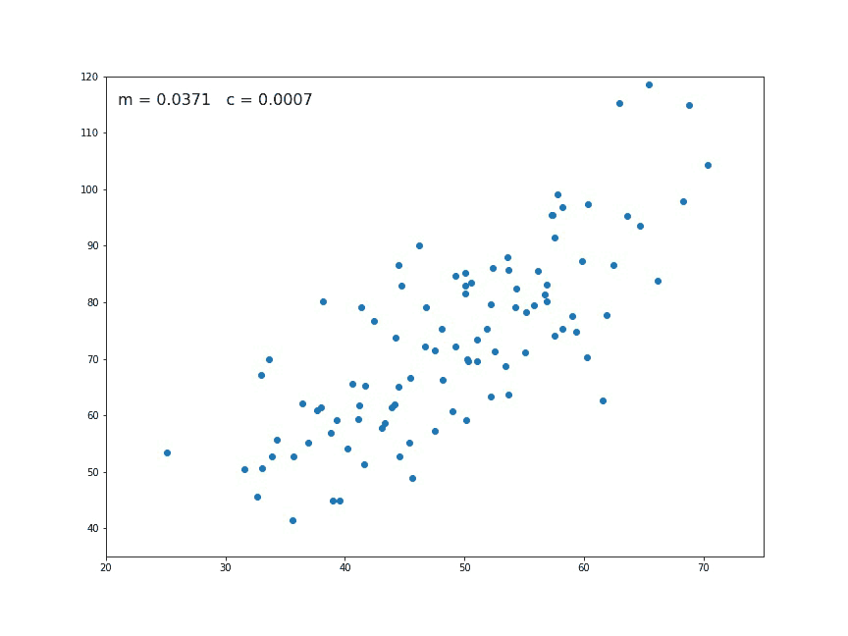

The values of m and c are updated at each iteration to get the optimal solution

Slide 13
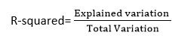
Goodness of fit
The Goodness of fit determines how the line of regression fits the set of observations.
R-squared method:
R-squared is a statistical method that determines the goodness of fit.
It measures the strength of the relationship between the dependent and independent variables on a scale of 0-100%.
The high value of R-square determines the less difference between the predicted values and actual values and hence represents a good model.
It is also called a coefficient of determination, or coefficient of multiple determination for multiple regression.
Formula:

Slide 14
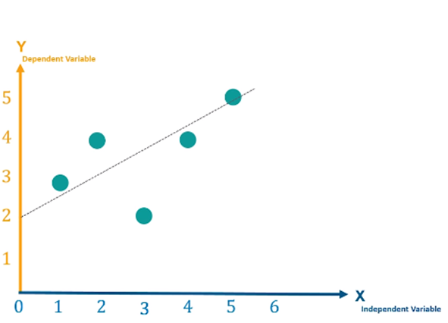
Example
X | Y
1 | 3
2 | 4
3 | 2
4 | 4
5 | 5
X=[1,2,3,4,5]
Y=[3,4,2,4,5]

Slide 15
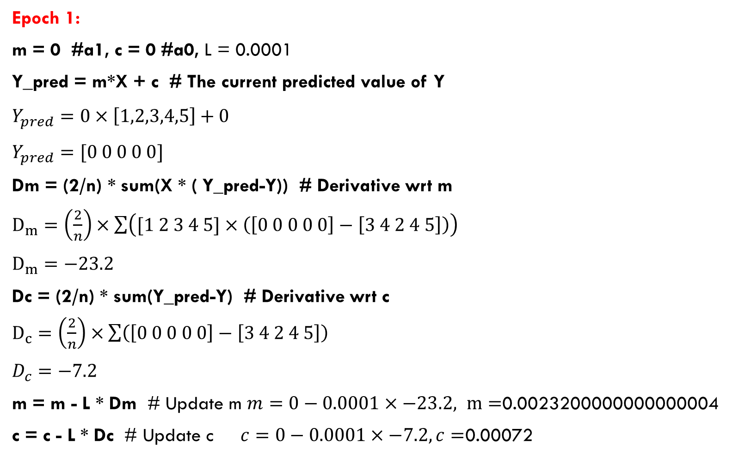
Epoch 1:
m = 0 #a1, c = 0 #a0, L = 0.0001
Y_pred = m*X + c # The current predicted value of Y
$Y_{pred}=0×\left[1,2,3,4,5\right]+0$
$Y_{pred}=[0 0 0 0 0]$
Dm = (2/n) * sum(X * ( Y_pred-Y)) # Derivative wrt m
$D_{m}=\left(\frac{2}{n}\right)×\sum{\left([1 2 3 4 5]×\left(\left[0 0 0 0 0\right]−\left[3 4 2 4 5\right]\right)\right)}$
$D_{m}=−23.2$
Dc = (2/n) * sum(Y_pred-Y) # Derivative wrt c
$D_{c}=\left(\frac{2}{n}\right)×\sum{\left(\left[0 0 0 0 0\right]−\left[3 4 2 4 5\right]\right)}$
$D_{c}=−7.2$
m = m - L * Dm # Update m $m=0−0.0001×−23.2, m=$0.0023200000000000004
c = c - L * Dc # Update c $c=0−0.0001×−7.2, c=$0.00072

Slide 16
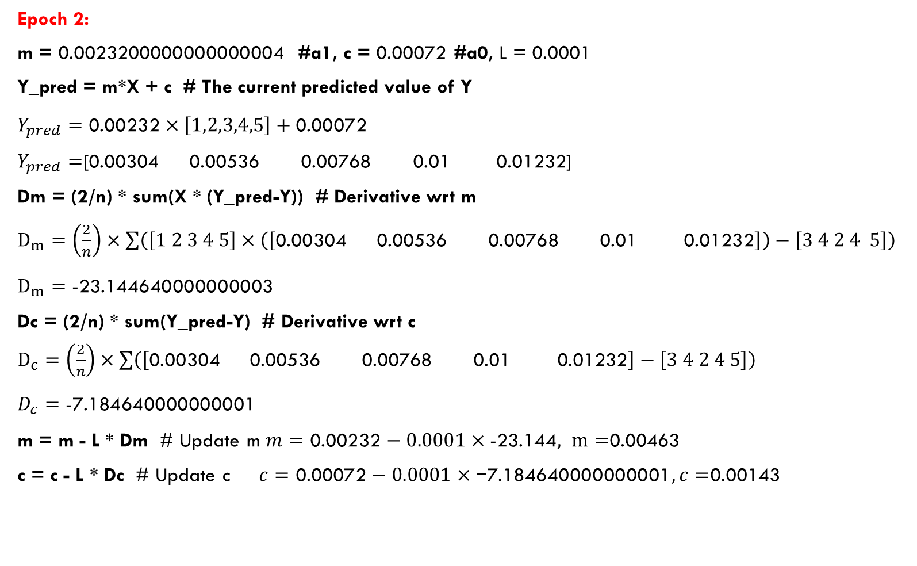
Epoch 2:
m = 0.0023200000000000004 #a1, c = 0.00072 #a0, L = 0.0001
Y_pred = m*X + c # The current predicted value of Y
$Y_{pred}=\text{0.00232}×\left[1,2,3,4,5\right]+\text{0.00072}$
$Y_{pred}=$[0.00304 0.00536 0.00768 0.01 0.01232]
Dm = (2/n) * sum(X * (Y_pred-Y)) # Derivative wrt m
$D_{m}=\left(\frac{2}{n}\right)×\sum{\left(\left[1 2 3 4 5\right]×\left(\left[\text{0.00304 0.00536 0.00768 0.01 0.01232}\right]\right)−\left[3 4 2 4 5\right]\right)}$
$D_{m}=\text{−23.144640000000003}$
Dc = (2/n) * sum(Y_pred-Y) # Derivative wrt c
$D_{c}=\left(\frac{2}{n}\right)×\sum{\left(\left[\text{0.00304 0.00536 0.00768 0.01 0.01232}\right]−\left[3 4 2 4 5\right]\right)}$
$D_{c}=\text{−7.184640000000001}$
m = m - L * Dm # Update m $m=\text{0.00232}−0.0001×\text{−23.144}, m=$0.00463
c = c - L * Dc # Update c $c=\text{0.00072}−0.0001×\text{−7.184640000000001}, c=$0.00143

Slide 17
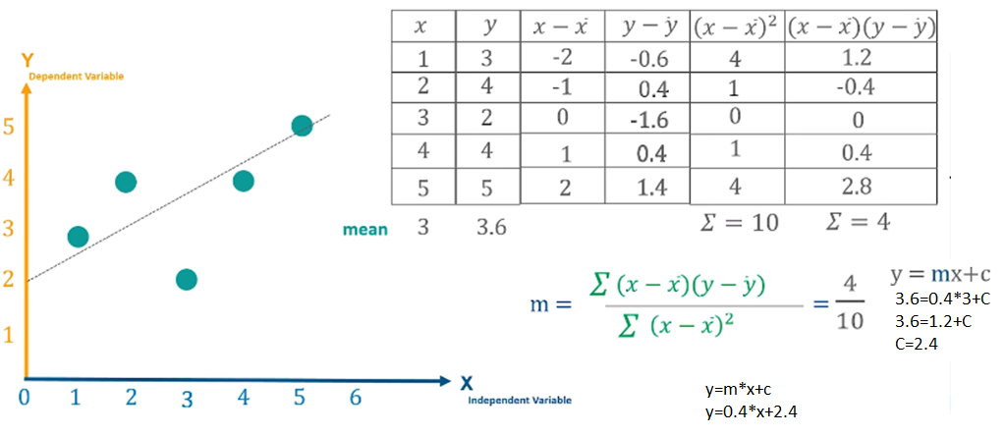
Example

Slide 18
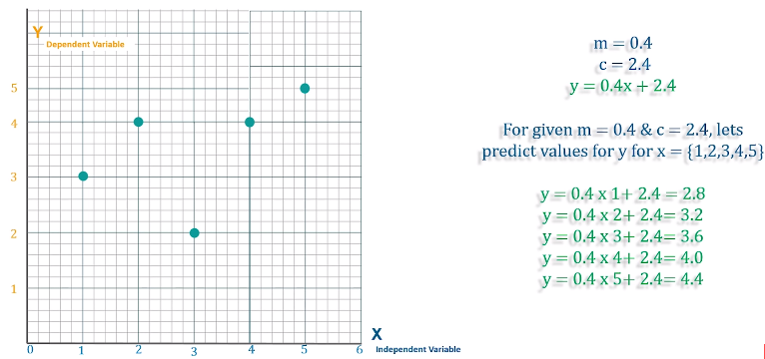
Mean square error

Slide 19
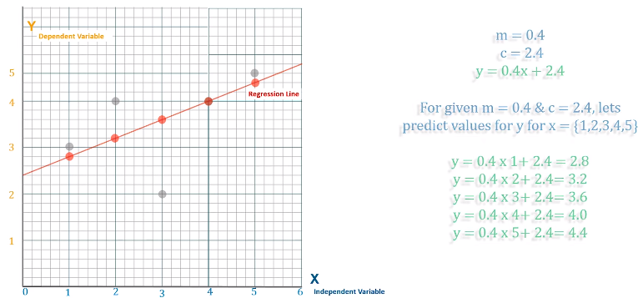
Mean square error

Slide 20
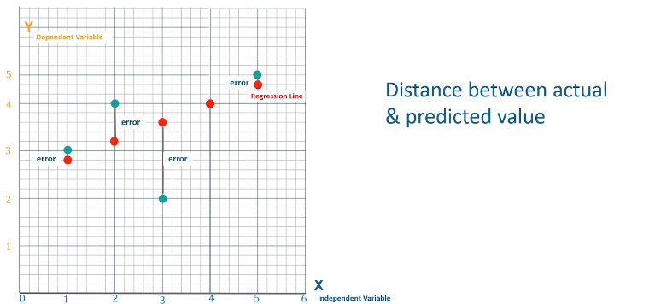
Mean square error

Slide 21
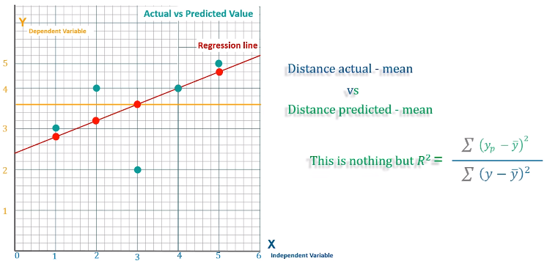
Goodness of fit-R2

Slide 22
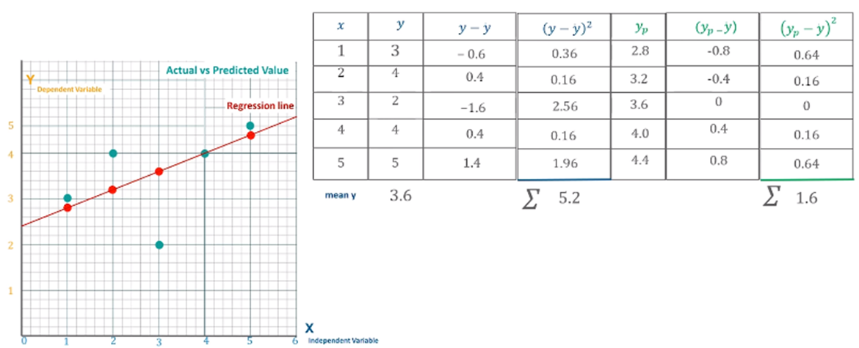
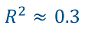
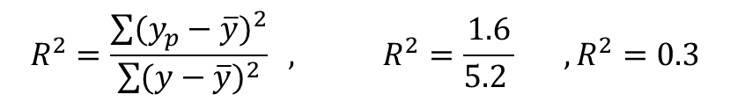
Goodness of fit
$$R^{2}=\frac{\sum{{(y_{p}−\overline{y})}^{2}}}{\sum{{(y−\overline{y})}^{2}}} , R^{2}=\frac{1.6}{5.2 } , R^{2}=0.3$$

Slide 23
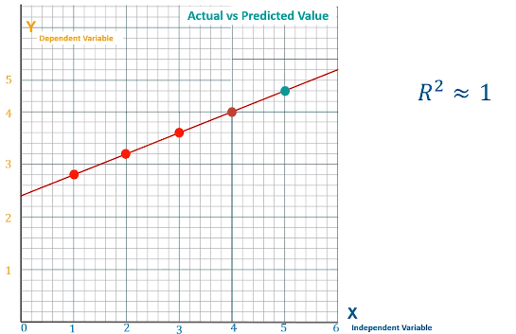
Goodness of fit

Slide 24
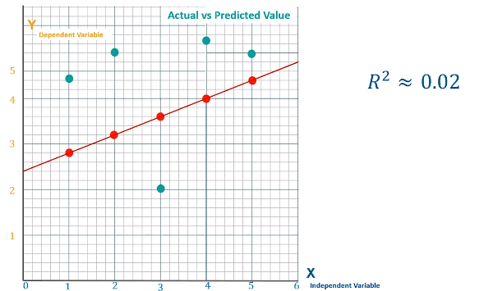
Goodness of fit

Slide 25
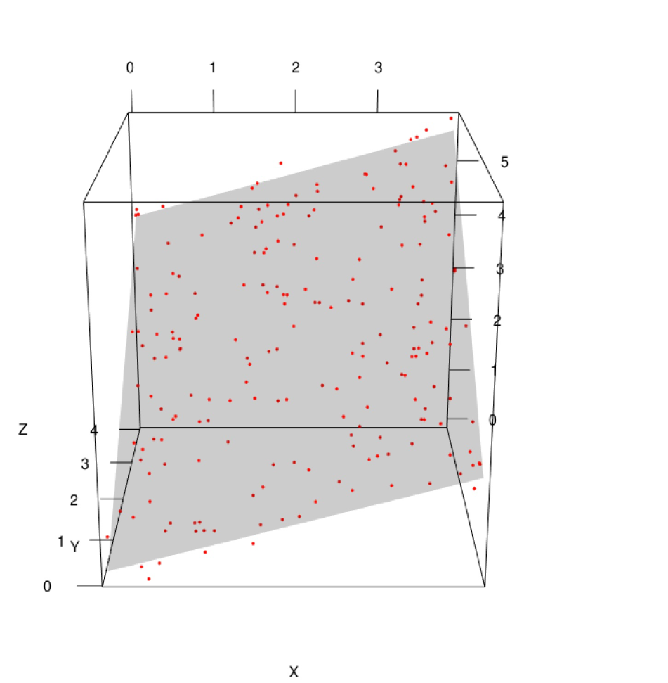
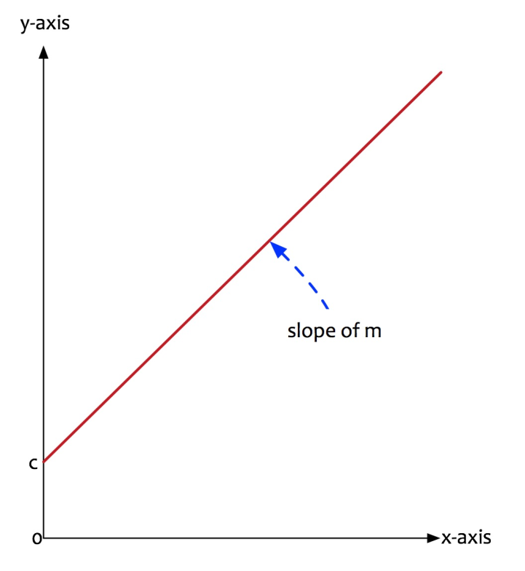
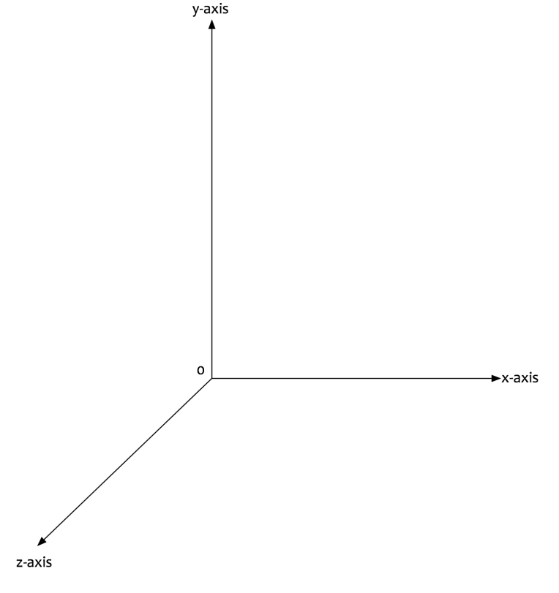
Multivariate Linear Regression
More than one independent variables are used to predict the value of a numerical dependent variable.

Slide 26
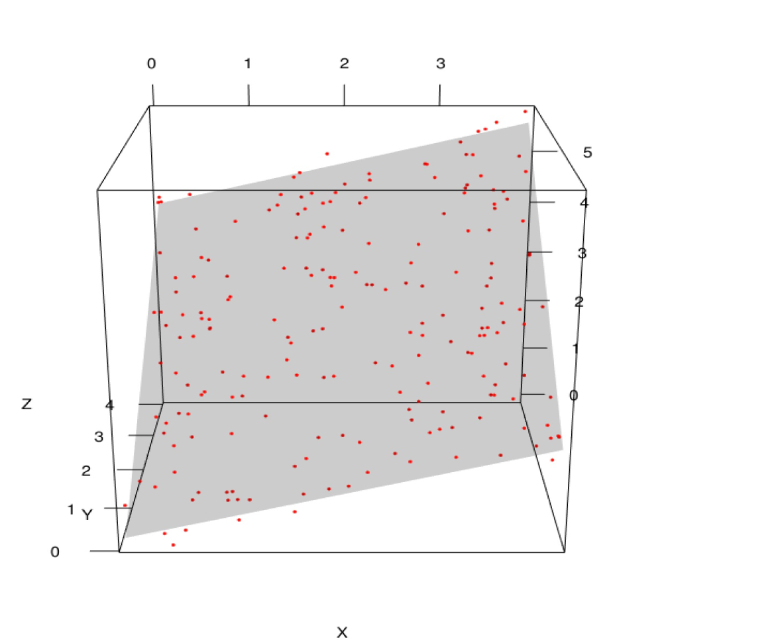
Multivariate Linear Regression
Y=f(x,z)
y = m1.x + m2.z+ c
y is the dependent variable i.e. the variable that needs to be estimated and predicted.
x is the first independent variable i.e. the variable that is controllable. It is the first input.
m1 is the slope of x1. It determines what will be the angle of the line (x).
z is the second independent variable i.e. the variable that is controllable. It is the second input.
m2 is the slope of z. It determines what will be the angle of the line (z).
c is the intercept. A constant that determines the value of y when x and z are 0.

Slide 27
Multivariate Linear RegressionRegression
model with two input variables can be expressed as:
y = β0 + β1.x1 + β2.x2
In machine learning world, there can be many dimensions. A model with three input variables can be expressed as:
y = β0 + β1.x1 + β2.x2 + β3.x3
A generalized equation for the multivariate regression model can be:
y = β0 + β1.x1 + β2.x2 +….. + βn.xn

Slide 28
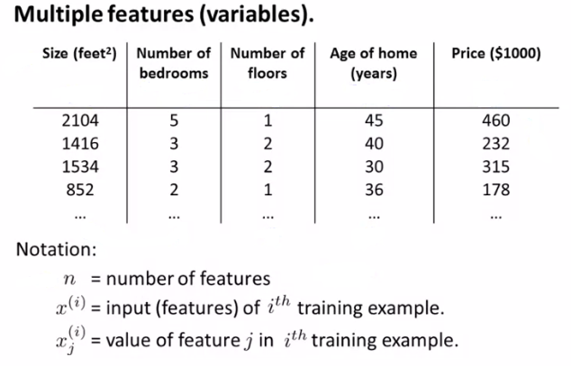
Multivariate Linear Regression
When we have multiple features and we want to train a model that can predict the price given those features, we can use a multivariate linear regression. The model will have to learn the parameters(theta 0 to theta n) on the training dataset below such that if we want to predict the price for a house that is not sold yet, it can give us prediction that is closer to what it will get sold for.

Slide 29
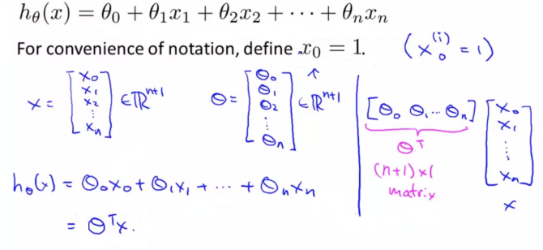
Multivariate Linear Regression

Slide 30
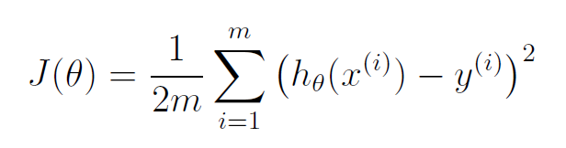
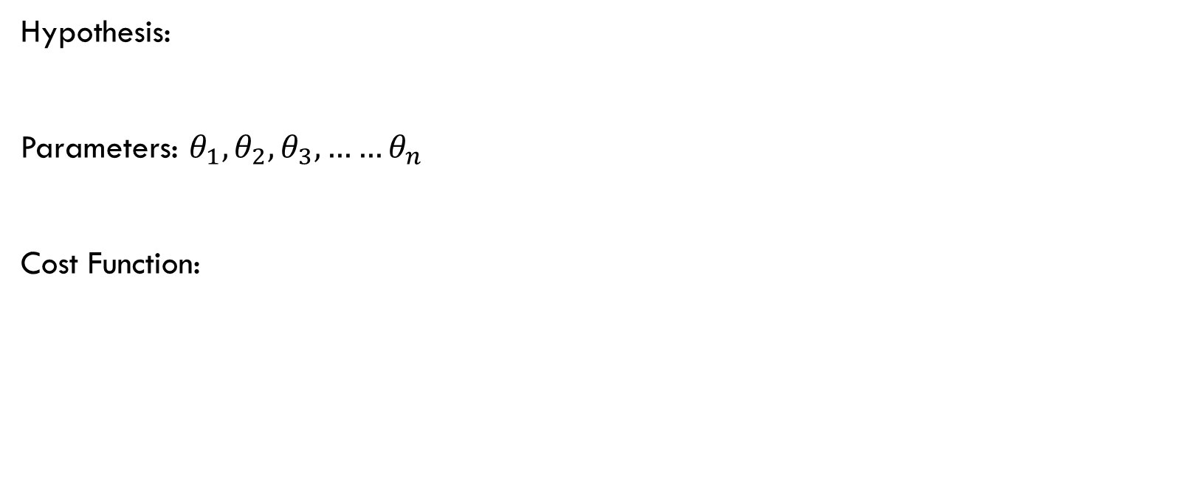
Cost Function and Gradient Descent for Multivariate linear regression
Hypothesis:
Parameters: $θ_{1},θ_{2},θ_{3},……θ_{n}$
Cost Function:

Slide 31
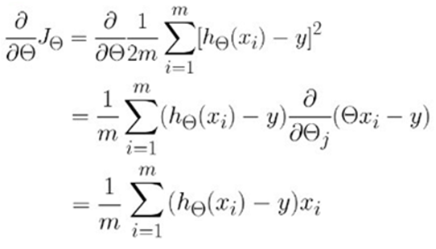
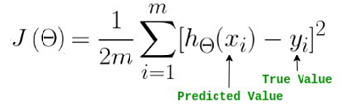
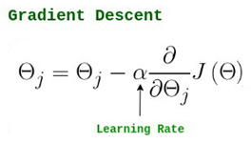
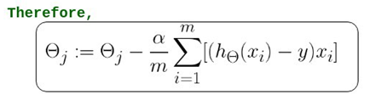
Gradient Descent

Slide 32
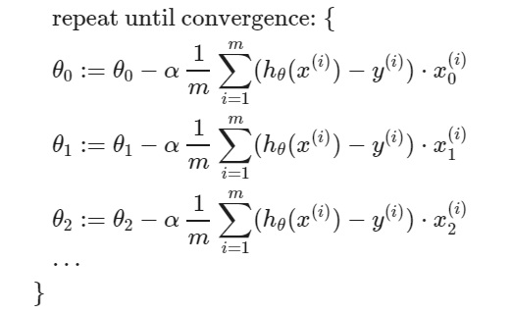
Gradient Descent
no of theta values = no of features + 1

Slide 33
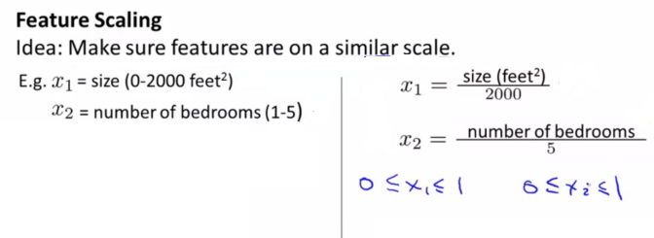
Practical Ideas for making Gradient Descent work well
Use feature scaling to help gradient descent converge faster. Get every feature between -1 and +1 range. It doesn’t have to be exactly in the -1 to +1 range but it should be close to that range.

Slide 34
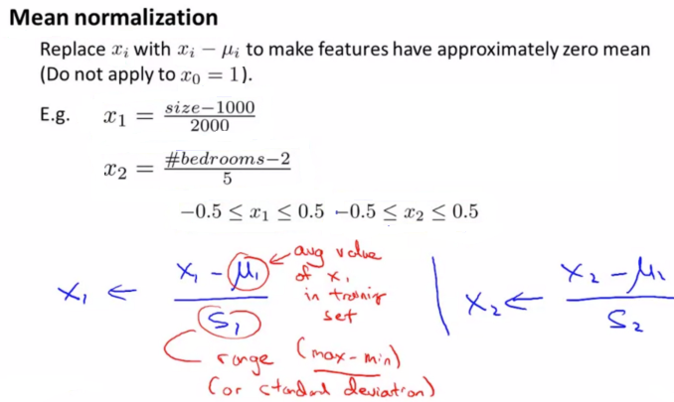
Practical Ideas for making Gradient Descent work well

Slide 35
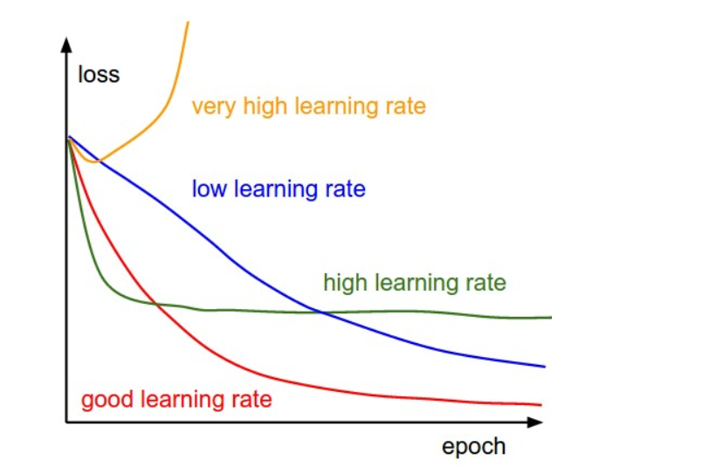
Practical Ideas for making Gradient Descent work well
If α is very small, it would take long time to converge and become computationally expensive.
If α is large, it may fail to converge and overshoot the minimum.
The most commonly used rates are : 0.001, 0.003, 0.01, 0.03, 0.1, 0.3.
Gradient descent with different learning rates.

Slide 36
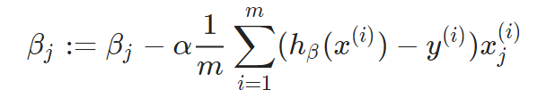
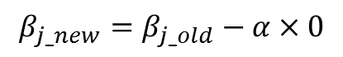
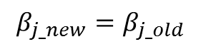
Steps
STEP1: Initialize values β0​, β1​,…, βn​ with some value. In this case we will initialize with 0. Pick a value for the learning rate α.
STEP 2: Make sure to scale the features (X) if it’s on a very different scales.
STEP 3: Iteratively update,
The algorithm will converge when slope becomes 0
$$β_{j_new}=β_{j_old}−α×0$$
$$β_{j_new}=β_{j_old}$$

Slide 37
Model Interpretation
y = -85090 + 102.85 * X1 + 43.79 * X2+ 1.52 * x3 - 37.91 * x4 + 908.12 * x5 + 364.33 * x6
x1: With all other predictors held constant, if the x1 is increased by one unit, the average price increases by $102.85.
x2: With all other predictors held constant, if the x2 is increased by one unit, the average price increases by $43.79.
x3: With all other predictors held constant, if the x3 is increased by one unit, the average price increases by $1.52.
x4: With all other predictors held constant, if the x4 is increased by one unit, the average price decreases by $37.91 (length has a -ve coefficient).
x5: With all other predictors held constant, if the x5 is increased by one unit, the average price increases by $908.12
x6t: With all other predictors held constant, if the x6 is increased by one unit, the average price increases by $364.33

Slide 38
Regularization

Slide 39
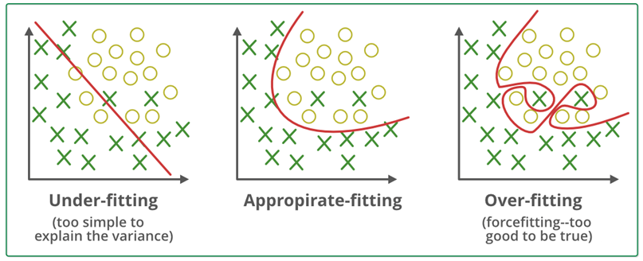
Problem of under-fitting and over-fitting
Regularisation is a technique used to reduce the errors by fitting the function appropriately on the given training set and avoid overfitting.

Slide 40
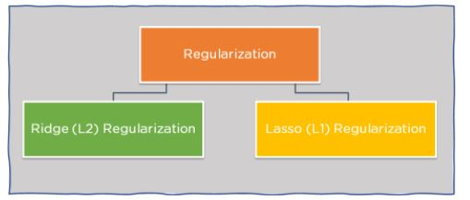
Regularisation in ML
Regularization refers to techniques that are used to calibrate machine learning models in order to minimize the adjusted loss function and prevent overfitting or underfitting.
Using Regularization, we can fit our machine learning model appropriately on a given test set and hence reduce the errors in it.
Note: LASSO (Least Absolute Shrinkage and Selection Operator)

Slide 41
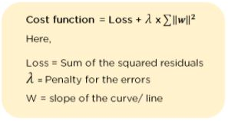
Ridge Regularization
It modifies the over-fitted or under fitted models by adding the penalty equivalent to the sum of the squares of the magnitude of coefficients.
Ridge Regression performs regularization by shrinking the coefficients present.
In the cost function, the penalty term is represented by Lambda λ. By changing the values of the penalty function, we are controlling the penalty term. The higher the penalty, it reduces the magnitude of coefficients. It shrinks the parameters. Therefore, it is used to prevent multicollinearity, and it reduces the model complexity by coefficient shrinkage.

Slide 42
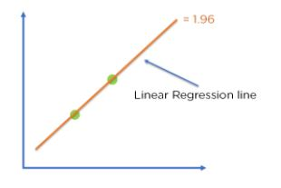
Ridge Regularization
Consider the graph illustrated below which represents Linear regression :
Cost function = Loss + λ x∑‖w‖^2
For Linear Regression line, let’s consider two points that are on the line,
Loss = 0 (considering the two points on the line)
λ= 1
w = 1.4
Then, Cost function = 0 + 1 x 1.42
= 1.96
For Ridge Regression, let’s assume,
Loss = 0.32 + 0.22 = 0.13
λ = 1
w = 0.7
Then, Cost function = 0.13 + 1 x 0.72
= 0.62

Slide 43

Ridge Regularization
Comparing the two models, with all data points, we can see that the Ridge regression line fits the model more accurately than the linear regression line.
Figure: Optimization of model fit using Ridge Regression

Slide 44

Lasso Regression
It modifies the over-fitted or under-fitted models by adding the penalty equivalent to the sum of the absolute values of coefficients.
Lasso regression also performs coefficient minimization, but instead of squaring the magnitudes of the coefficients, it takes the true values of coefficients. This means that the coefficient sum can also be 0, because of the presence of negative coefficients.
We can control the coefficient values by controlling the penalty terms, just like we did in Ridge Regression.

Slide 45


Cost function = Loss + λ x ∑‖w‖
For Linear Regression line, let’s assume,
Loss = 0 (considering the two points on the line)
λ = 1
w = 1.4
Then, Cost function = 0 + 1 x 1.4
= 1.4
For Ridge Regression, let’s assume,
Loss = 0.32 + 0.12 = 0.1
λ = 1
w = 0.7
Then, Cost function = 0.1 + 1 x 0.7
= 0.8
Figure: Linear Regression Model
Comparing the two models, with all data points, we can see that the Lasso regression line fits the model more accurately than the linear regression line.

Slide 46

Probelm
$$BMI$$ | $$Cholesterol$$
17 | 140
21 | 189
24 | 210
28 | 240
14 | 130
16 | 100
19 | 135
22 | 166
15 | 130
18 | 170
A clinical trial gave the following data for BMI and Cholesterol level for 10 patients. Predict the likely value of cholesterol level for someone who has a BMI of 27.

Slide 47

Solution:
$$BMI$$ | $$Cholesterol$$ | $$X_{i}−\overline{X}$$ | $$Y_{i}−\overline{Y}$$ | $$(X_{i}−\overline{X}) ×{(Y}_{i}−\overline{Y)}$$ | $${{(X}_{i}−\overline{X})}^{2}$$
$$BMI$$ | $$Cholesterol$$ | $$X_{i}−\overline{X}$$ | $$Y_{i}−\overline{Y}$$ | $$(X_{i}−\overline{X}) ×{(Y}_{i}−\overline{Y)}$$ | $${{(X}_{i}−\overline{X})}^{2}$$
17 | 140 | -2.4 | -21 | 50.4 | 5.76
21 | 189 | 1.6 | 28 | 44.8 | 2.56
24 | 210 | 4.6 | 49 | 225.4 | 21.16
28 | 240 | 8.6 | 79 | 679.4 | 73.96
14 | 130 | -5.4 | -31 | 167.4 | 29.16
16 | 100 | -3.4 | -61 | 207.4 | 11.56
19 | 135 | -0.4 | -26 | 10.4 | 0.16
22 | 166 | 2.6 | 5 | 13 | 6.76
15 | 130 | -4.4 | -31 | 136.4 | 19.36
18 | 170 | -1.4 | 9 | -12.6 | 1.96
$$\overline{X }=19.4$$ | $\overline{Y}$ =161 |  |  | Total=1522 | Total=172.4

Slide 48

The repression line equation is $Y=a_{0}+a_{1}×X$
$a_{1}=\frac{\sum{(X_{i}−\overline{X}) ×{(Y}_{i}−\overline{Y)} }}{\sum{{{(X}_{i}−\overline{X})}^{2} }}$
$a_{1}=\frac{1522}{172.4}=8.8283$
$a_{0}=\overline{Y}−a_{1}×\overline{X}$
$a_{0}=161−8.8283×19.4=−10.2690$
Hence the regression line is $Y=−10.2690$+$8.8283×$X
Hence someone having a BMI of 27 would likely have cholesterol level as
$\text{C}\text{holesterol} =−10.2690$+$8.8283×$27
Cholesterol =228

Slide 49


